Slide 1
Elements of Art and Principles of Design

Slide 2
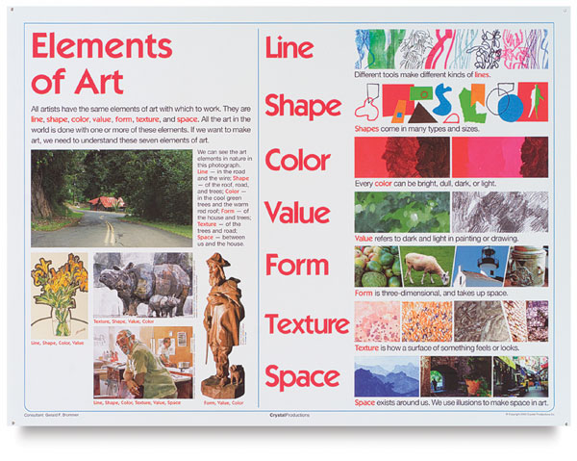
Elements of Art
The elements of art are the basic vocabulary of art
We call them the building blocks of art
Line, shape, form (volume and mass), value (light and dark), color, texture, space, time and motion

Slide 3
VALUE
Value – An Element of Art that describes the lightness or darkness of a hue.

Slide 4
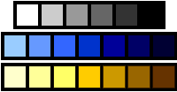
Value
Value - is the degree of light and dark in a design.
It is the contrast between black and white and all the tones in between.
Value can be used with color as well as black and white.

Slide 5
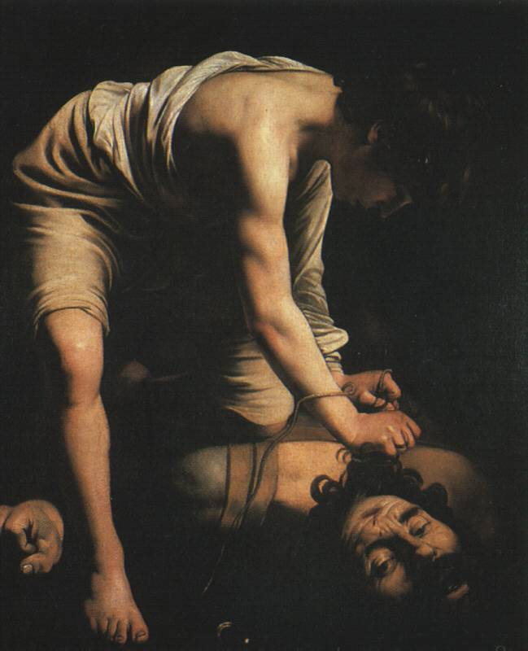
Value
Contrast can show changes between values.
Value is needed to express Volume.
Volume is the representation of mass in an art work or a sculpture.
How did Caravaggio use value
to express volume in “David and Goliath."

Slide 6
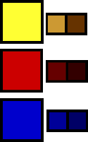
Value: Shades
Shades are dark values of a color.
Shades are made by mixing a color with different amounts of black.

Slide 7
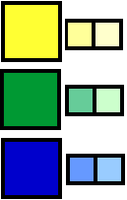
Value: Tints
Tints are light values of a color.
Tints are made by mixing a color with different amounts of white.

Slide 8
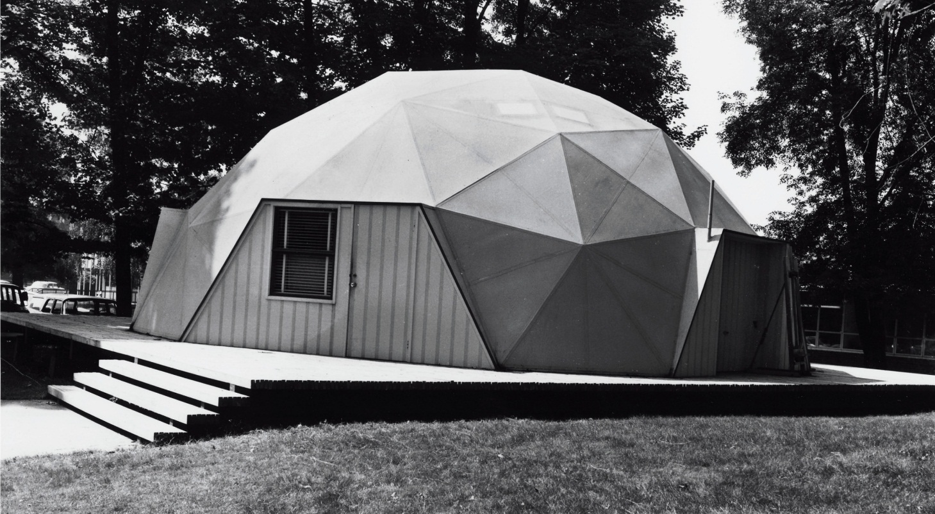
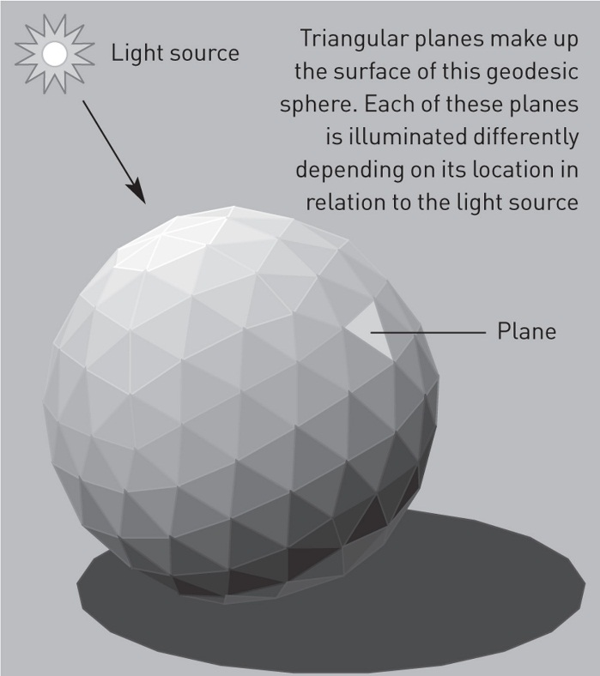
Value:
Value refers to lightness and darkness
Value can produce a sense of solidity and influence our mood
Darker works of art seem to have a “darker mood”
Artists learn to mimic the way things look by observing light as it illuminates a surface
Value changes often occur gradually
Notice in the dome the relative dark values increases as the planes get farther away and do not face the light source
Buckminister Fuller, Geodesic Dome, 1963-79, Reed College, Portland, Oregan
Values and Planes of a geodesic sphere, vector graphic

Slide 9
Value
There are several value techniques that artists use to imply light within works of art. These techniques result in the illusion of shape and mass of objects.
Value: Relative lightness or darkness.
Shading/Modeling: Using chiaroscuro or values to create mass.
Chiaroscuro: Italian for light/dark; contrasts of light and shadow.

Slide 10
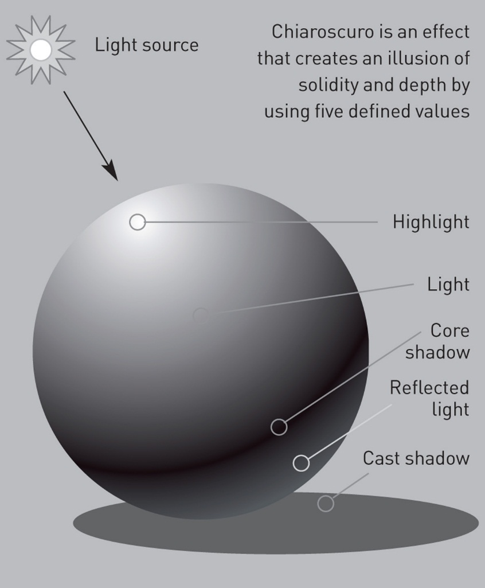
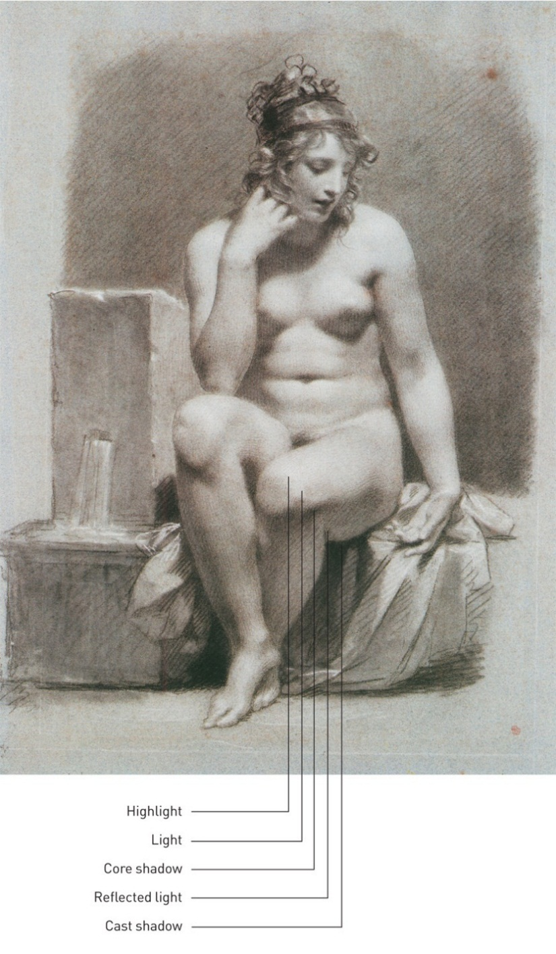
Chiaroscuro
Chiaroscuro – Italian for “light-dark”
Method of applying value to a two-dimensional piece of artwork to create the illusion of a three-dimensional solid form
Highlights marks the point where the object is most directly lit – often depicted as a bright white
From highlight moving progressively to the shadow less light is cast on the object until the point is reached where the surface faces away from the light
Diagram of Chiaroscuro
Chiaroscuro graphic applied to Pierre-Paul Prud’hon, Study for La Source, c. 1801, Black and white chalk on blue paper

Slide 11
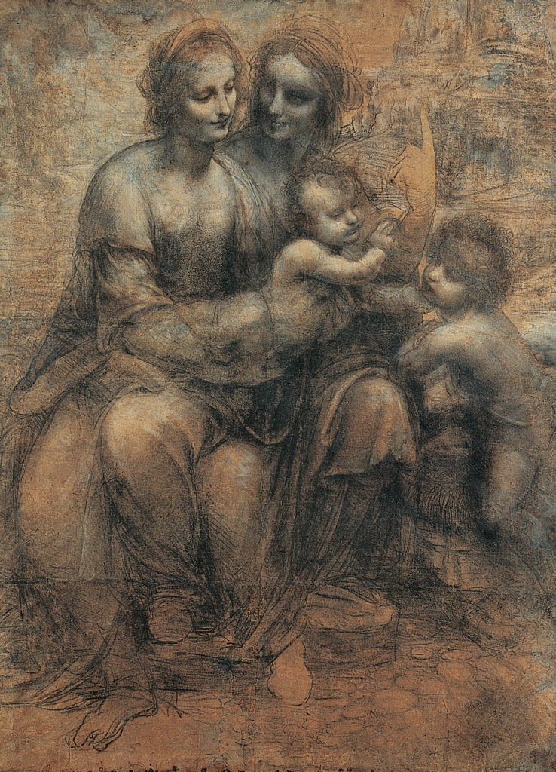
Value
Shading/Modeling: Using chiaroscuro or values to create mass.
Value: Relative lightness or darkness.
Chiaroscuro: Italian for light/dark; contrasts of light and shadow.
Leonardo da Vinci. The Virgin and Saint Anne with the Christ Child and the Young John the Baptist. Charcoal heightened with white on brown paper, 54-7/8 x 39-7/8 inches. © The National Gallery,
Notes:
In painting and drawing, artists often use the technique of chiaroscuro to describe the way shadows and light define the shape of forms.
Chiaroscuro is an Italian term that means “light-dark.”

Slide 12
Value
There are several value techniques that artists use to imply light within works of art. These techniques result in the illusion of shape and mass of objects.
Hatching: Closely spaced parallel lines.
Cross-hatching: Parallel lines intersect like a checkerboard.
Stippling: Dots spaced close or far apart to suggest darker or lighter areas.
© 2016, McGraw-Hill Higher Education. All rights reserved.

Slide 13
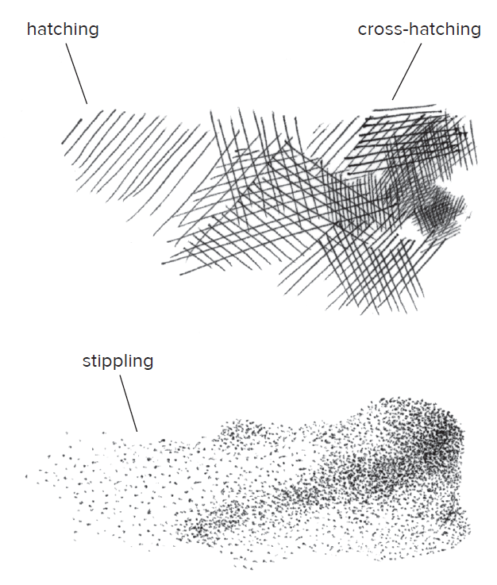
Value
Hatching: Closely spaced parallel lines.
Cross-hatching: Parallel lines intersect like a checkerboard.
Stippling: Dots spaced close or far apart to suggest darker or lighter areas.
Techniques for modelling mass with lines: Hatching, cross-hatching and stippling.

Slide 14
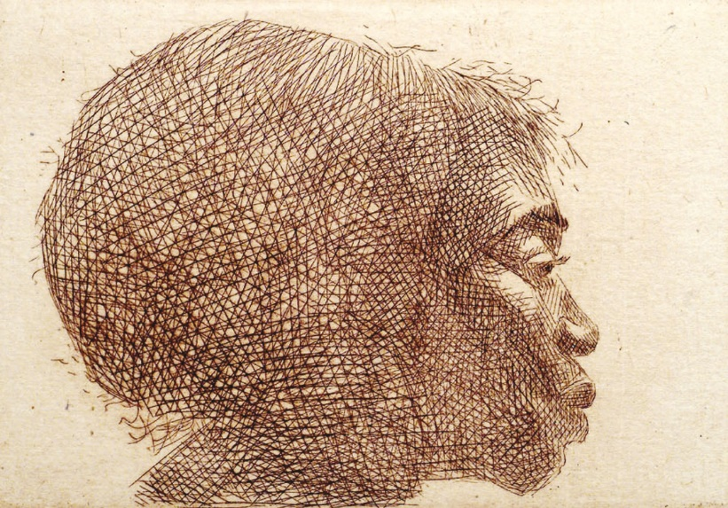
Value
Hatching: Closely spaced parallel lines.
Cross-hatching: Parallel lines intersect like a checkerboard.
Stippling: Dots spaced close or far apart to suggest darker or lighter areas.
Charles White. Untitled (Profile of a Woman facing right), 1979. Etching, 4 x 5-1/2 inches. Photo Darryl Allan Smith. © 1979 The Charles White Archives. Medium Prints and Manuscripts
Notes:
Charles White’s Untitled illustrates the technique of hatching.
Hatching is closely spaced parallel lines that create modeling in a 2D shape.

Slide 15
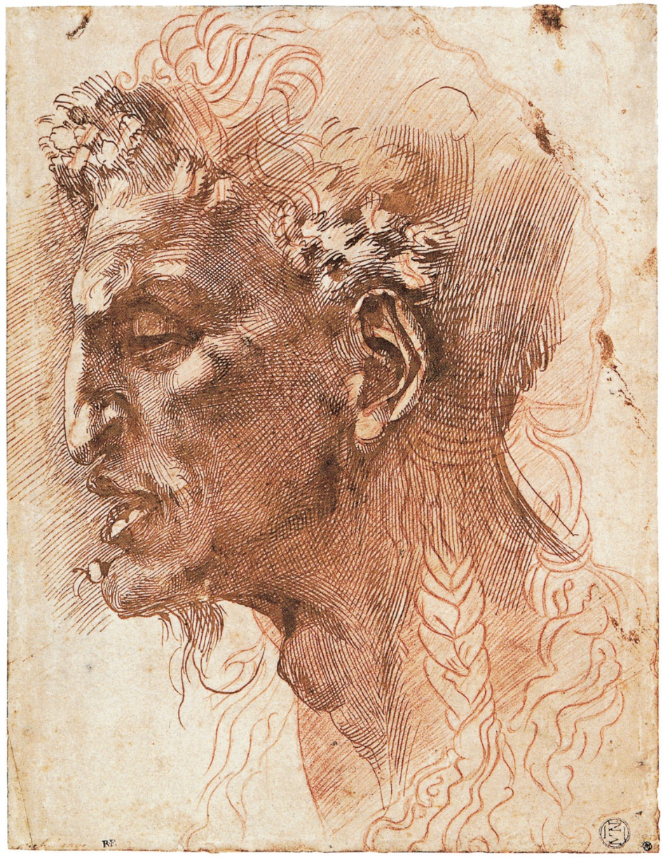
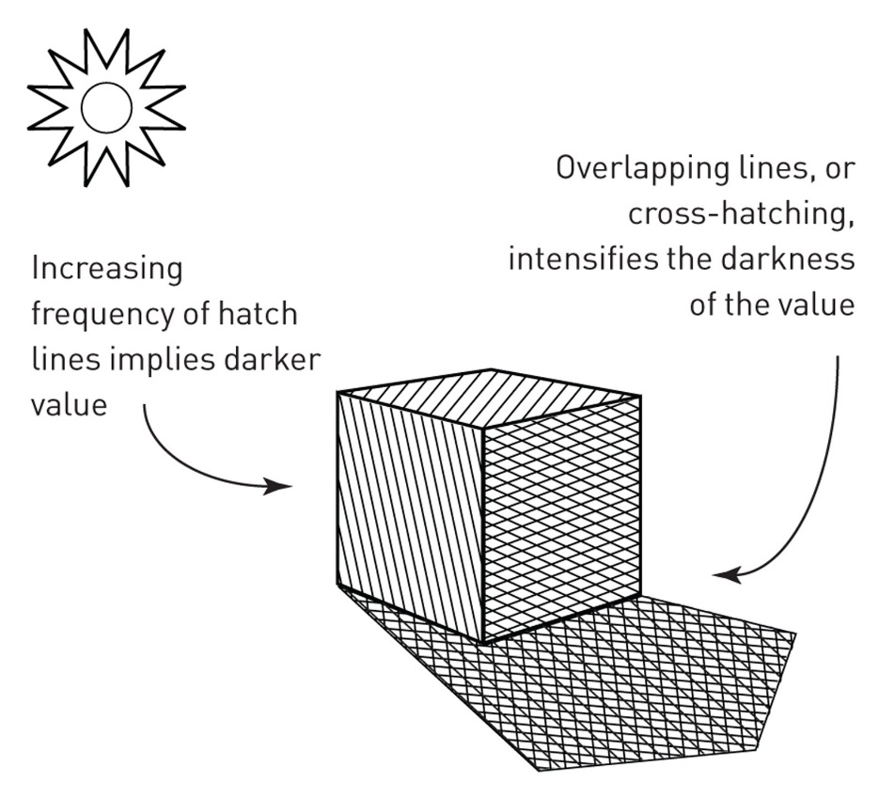
Hatching and Cross-Hatching
Hatching – method of expressing value with a series of lines close to and parallel to each other
Cross-Hatching – a variant of hatching where the lines cross each other
Creating Value using hatching and cross-hatching
Michelangelo, Head of a Satyr, c. 1520-30. Pen and Ink on Paper

Slide 16
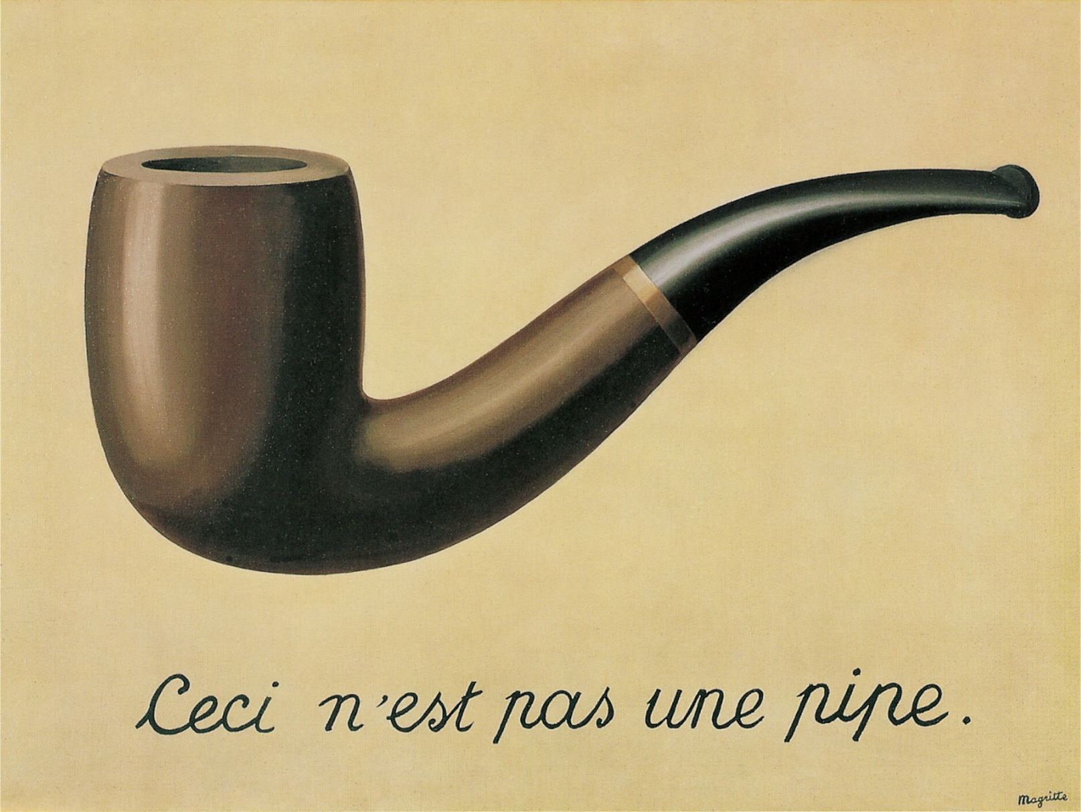
Implied Depth: Value, space, and perspective
Implied Depth involves the appearance of three-dimensional depth on a two-dimensional surface
Implied depth creates the illusion of three dimensions
Rene Magritte, The Treachery of Images (This is not a pipe), 1929, Oil on Canvas

Slide 17
The 9-Step Value Scale
9 | 8 | 7 | 6 | 5 | 4 | 3 | 2 | 1
DARKS | MIDS | LIGHTS

